Slide 1

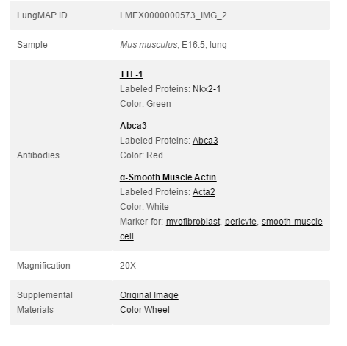
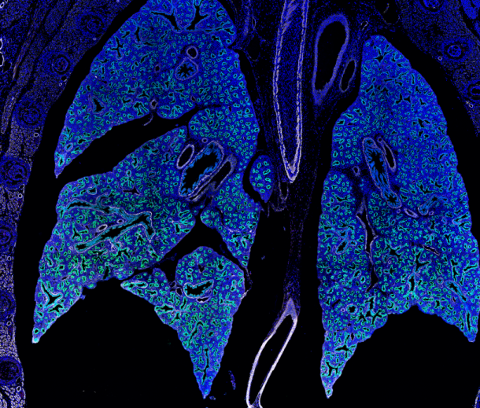


LungMap
Introduction | Purpose and Strategy
Purpose: develop a statistical learning pipeline to automatically classify immunofluorescent images of developing mouse lungs in the LungMAP database
Purpose and Strategy
Image Segmentation
Strategy:
Results and Future Steps
Lung Image
Extract metadata from the image by using SPARQL queries
Image Metadata
Segment the image using parameters defined by the metadata information
Image
Number of Bronchioles
Number of Acinar Tubules
Percentage area of muscle
Etc…
Annotate the image by pointing out the structures found with the segmentation
Image information file
JSON file containing segmentation data
Data +
LungMap project
Pablo Ortiz
Vivek Sriram
Lina Yang

Slide 2
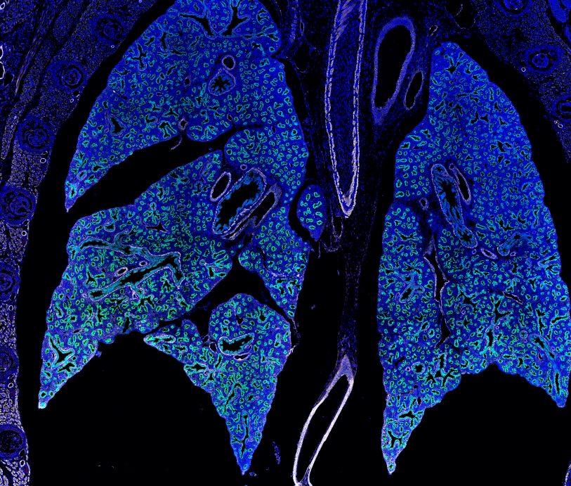
LungMap
Progress | Image Segmenting
Purpose: develop a statistical learning pipeline to automatically classify immunofluorescent images of developing mouse lungs in the LungMAP database
Purpose and Strategy
Image Segmentation
Strategy:
Results and Future Steps
Lung Image
Apply SPARQL queries to collect metadata
Determine segmentation parameters given image metadata
Annotate the image by pointing out the structures within
Data +
LungMap project
Pablo Ortiz
Vivek Sriram
Lina Yang
JSON file of segmentation data

Slide 3
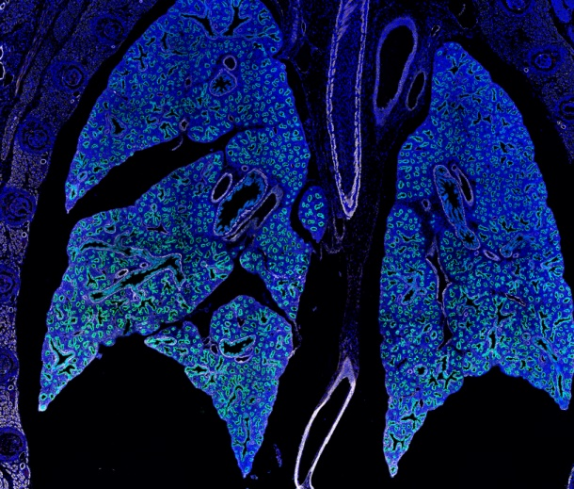
LungMap
Conclusion | Results and Future Steps
Purpose: develop a statistical learning pipeline to automatically classify immunofluorescent images of developing mouse lungs in the LungMAP database
Purpose and Strategy
Image Segmentation
Strategy:
Results and Future Steps
Lung Image
Extract metadata from the image by using SPARQL queries
Image Metadata
Segment the image using parameters defined by the metadata information
Image
Number of Bronchioles
Number of Acinar Tubules
Percentage area of muscle
Etc…
Annotate the image by pointing out the structures found with the segmentation
Image information file
JSON file containing segmentation data
Data +
LungMap project
Pablo Ortiz
Vivek Sriram
Lina Yang

